Slide 1



Google Apps for Learning
&
Digital Citizenship
Notes:
The following sequence of lessons refers to Laptop only lessons
https://copy-of-keyboard-hero-801886913830.us-west1.run.app/
https://keyboard-hero-801886913830.us-west1.run.app/

Slide 2
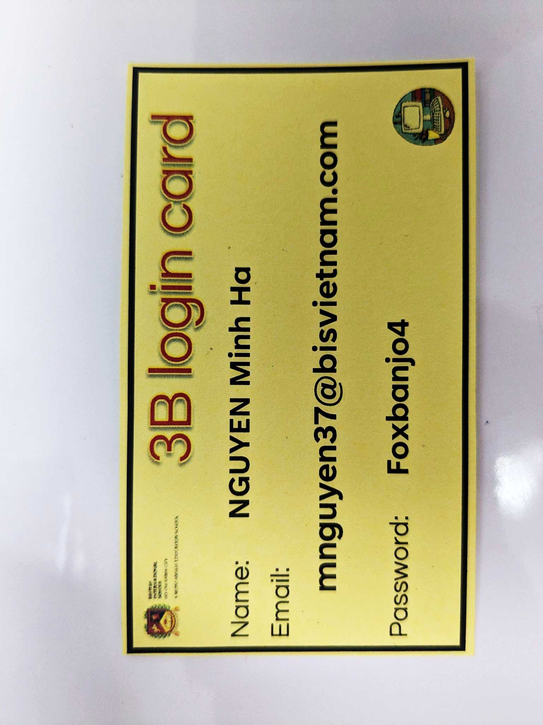
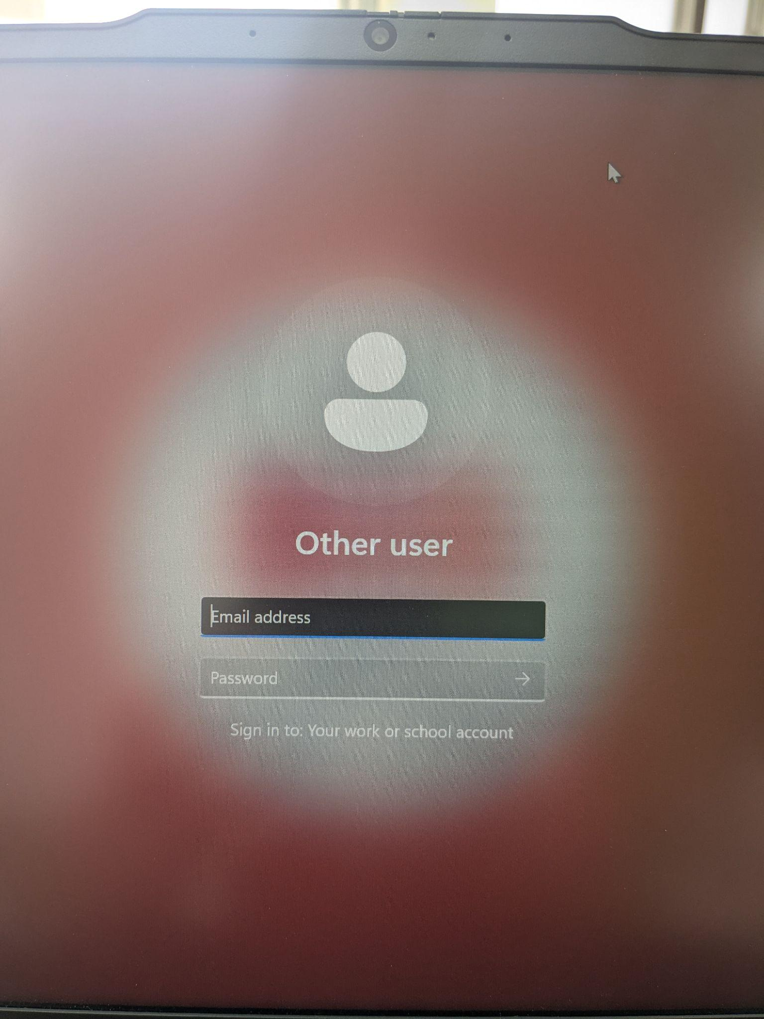
Shift + 2 | @
Shift + -/_ | Under_score
Shift + b | B (capital letter

Slide 3
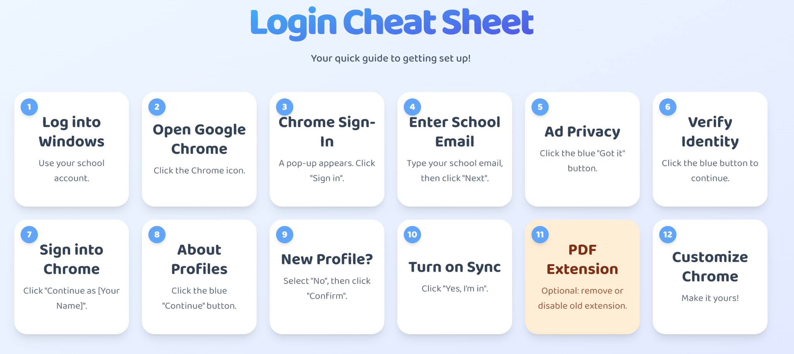
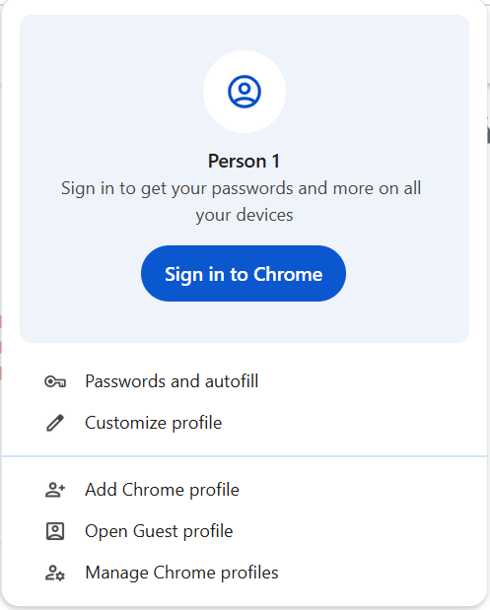



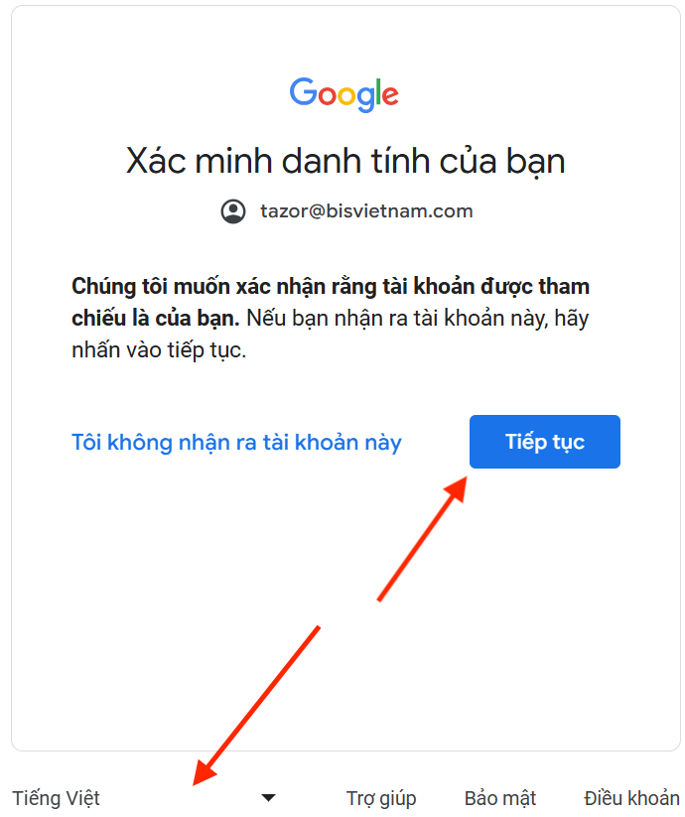


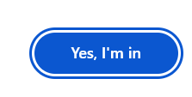
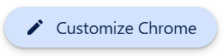

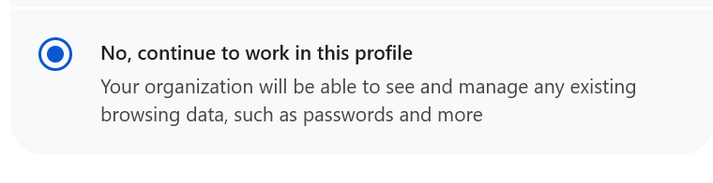
Your name

Slide 4
HARD THINKING QUESTION
Explain how you know you are signed in to the computer correctly!

Slide 5
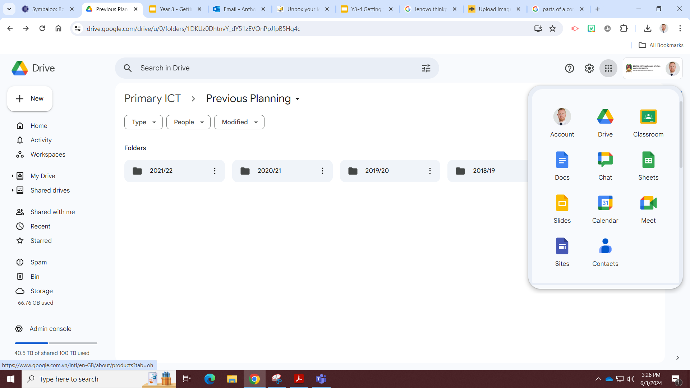
The Waffle

Slide 6
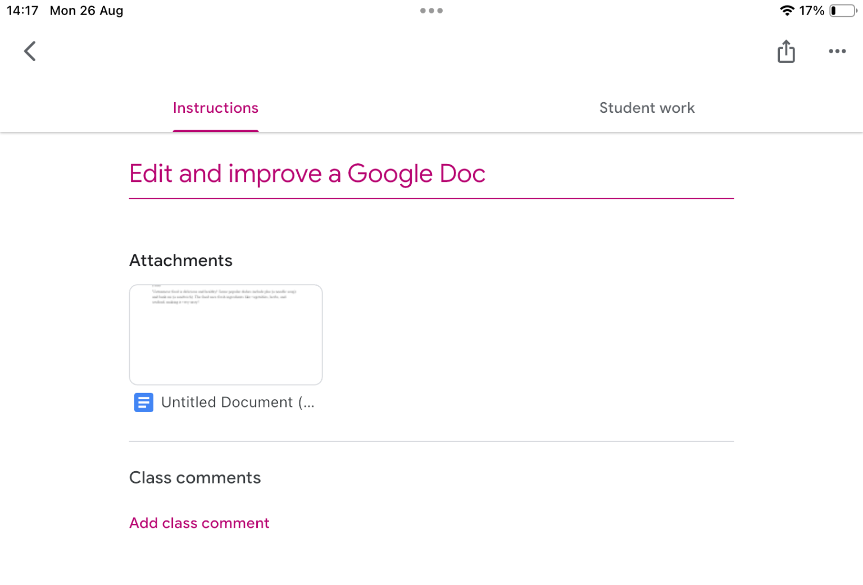
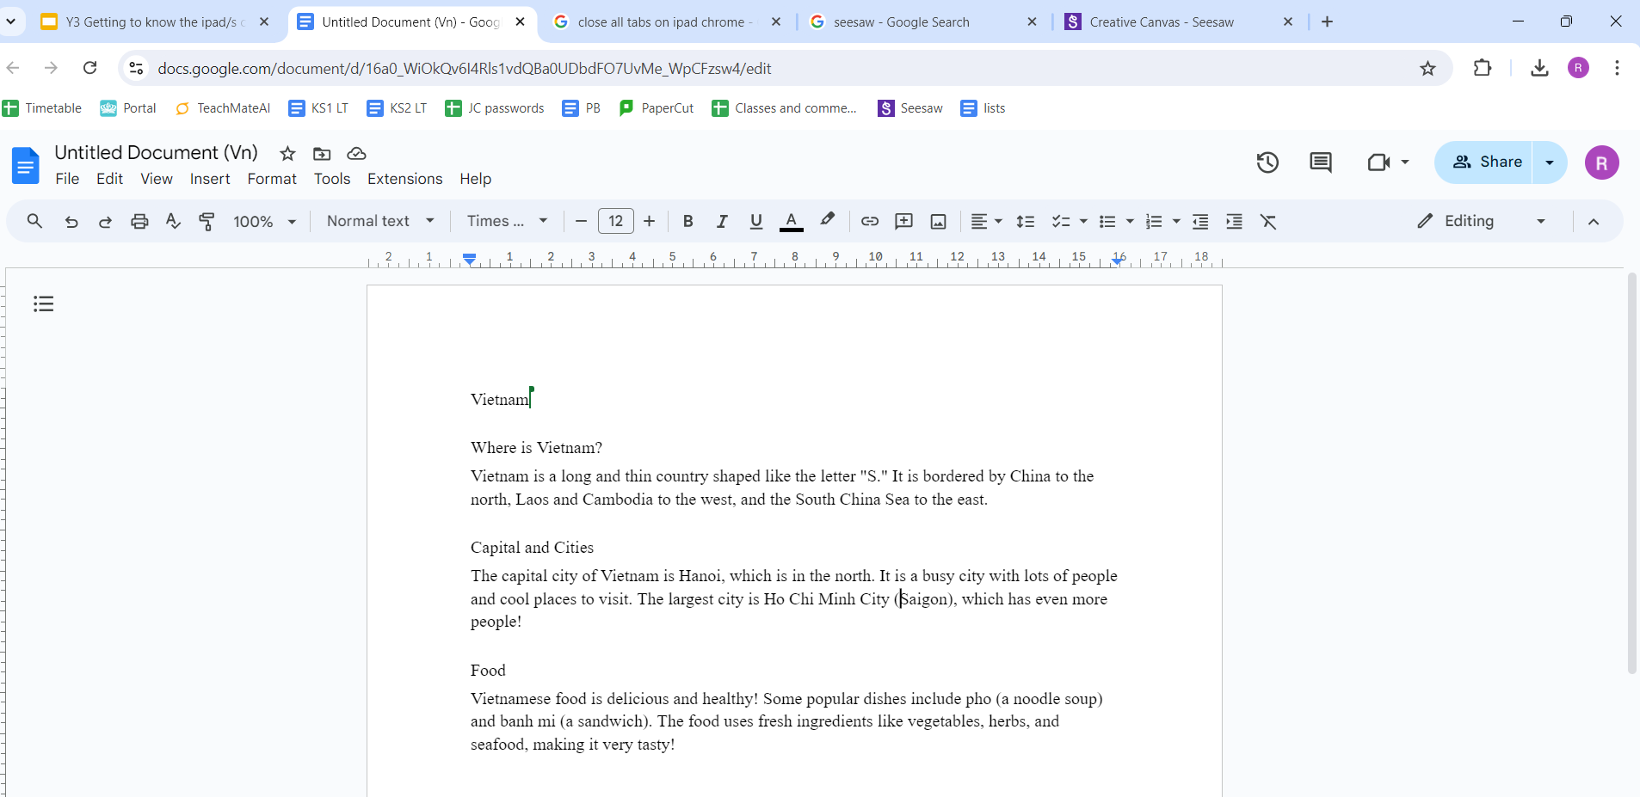
How to find and edit a doc on a Laptop
Notes:
Deploy on G-Class:https://docs.google.com/document/d/1R7_8utssn00nZXfFDzJ_9XFHC5QduA9AhzPUwEcaizs/edit?usp=sharing

Slide 7

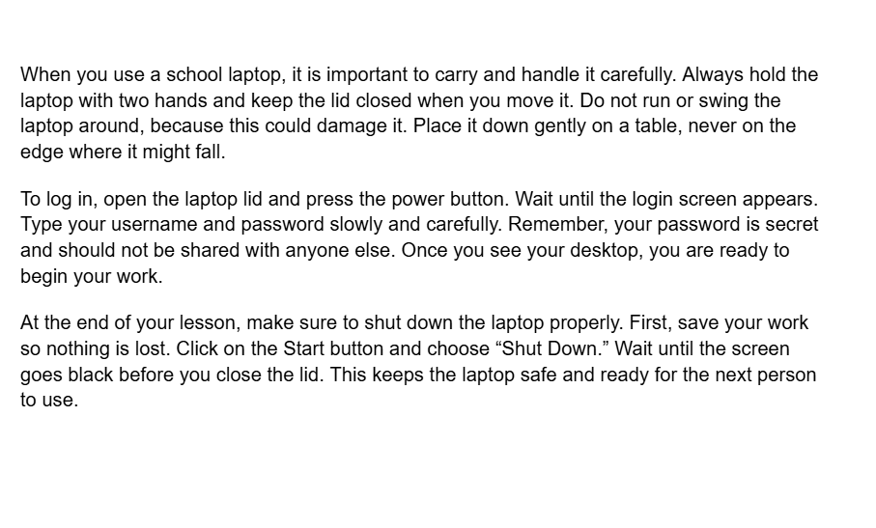
Improve a Google Doc!
Title: How to use my laptop
Use BOLD on Headings
Underline Headings
Align my titles
Change Font Style.
Change Font Size
Change Font colour
Add images
Use bullet points
Boring!
Challenge!
Notes:
Deploy via G-Class

Slide 8
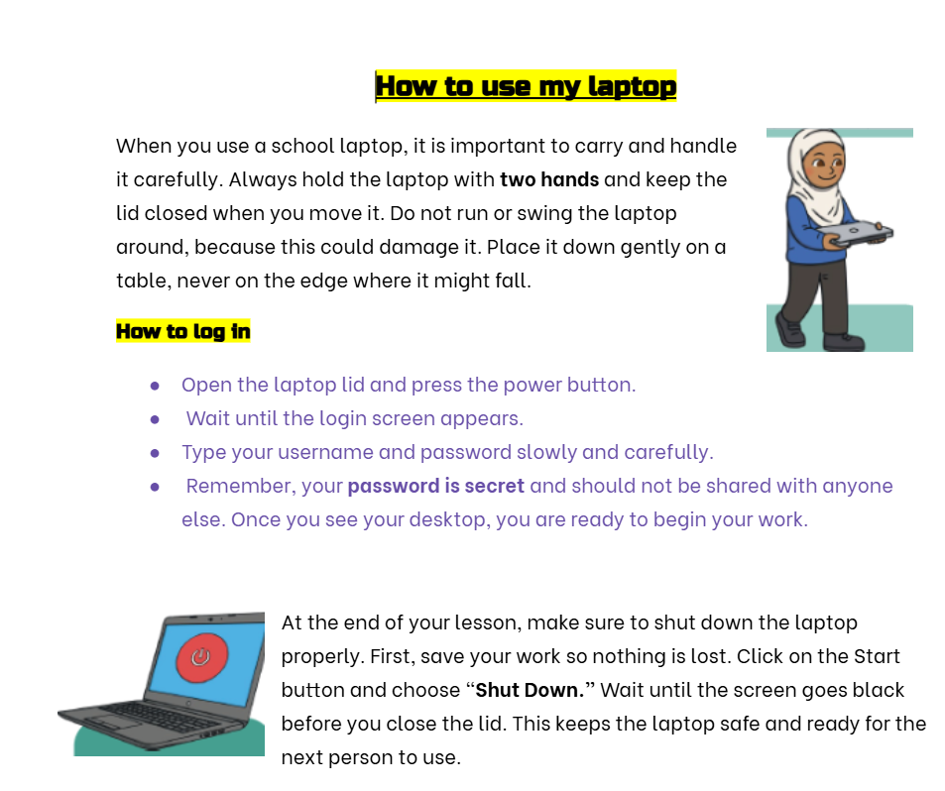


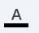

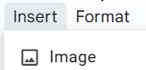

Notes:
WAGOLL: https://docs.google.com/document/d/1cA-nWsv8B7CCYvdb1677k_I-_neIniYgfFciPXMR8Kk/edit?usp=sharing

Slide 9

Quiz time!
Test you knowledge on Google Doc Icons
Notes:
https://wayground.com/admin/quiz/68a42206d1442fac62e2e01e
Deploy to students

Slide 10
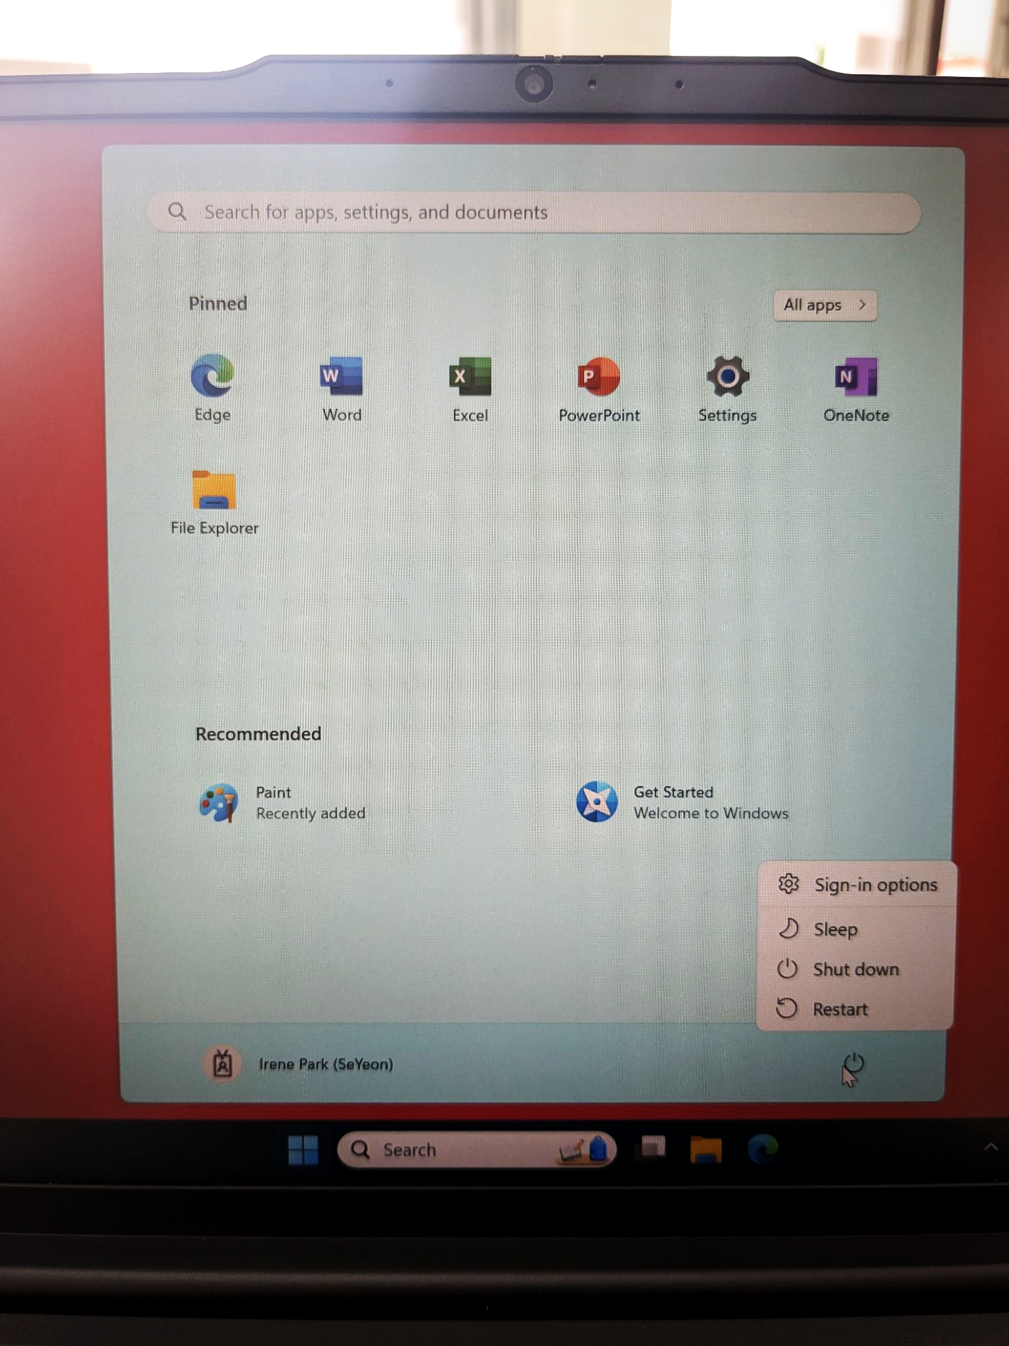
Shut down your laptop:
After every lesson please shut the laptop down so it is ready for the next person!

Slide 11

Google Apps for Learning
&
Digital Citizenship
Notes:
The following sequence of lessons refers to Laptop only lessons

Slide 12
Logging in:
Login

Slide 13
Knowledge retrieval question
What do these buttons do in Google Docs?

Slide 14

Private vs Personal information

Slide 15
HARD THINKING QUESTION
“Why do you think your password is private, but your first name is usually okay to share?”

Slide 16
The Waffle

Slide 17
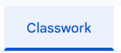
Open the template
Notes:
Deploy via G-Class room

Slide 18

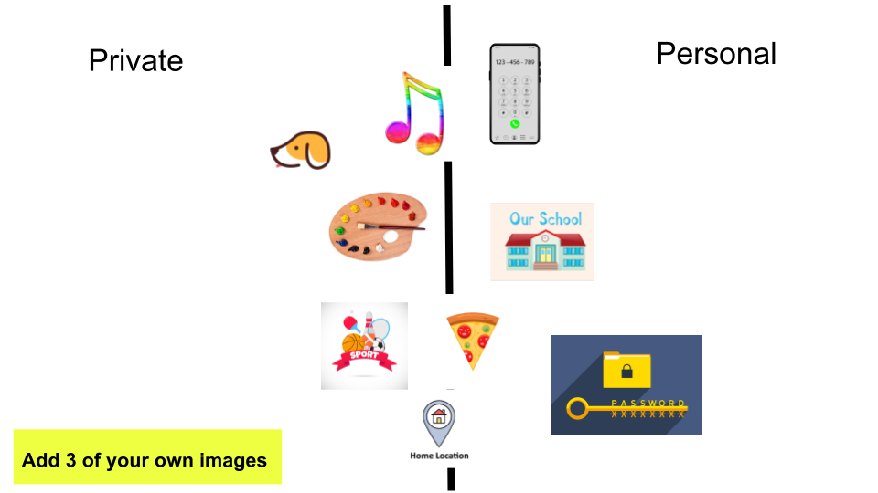
Edit the Google Slide
Format text:
Font, size, colour
Apply a slide theme
Organise images
Insert images
Resize images
Add text
Add animations
Notes:
Deploy via G-Class https://docs.google.com/presentation/d/1eunL40ewBwCh3Lpp9UjHQp-eh3FpzZZD7eWF6kT_o_U/edit?slide=id.g3764237b81a_0_16#slide=id.g3764237b81a_0_16
Model each of those skills

Slide 19
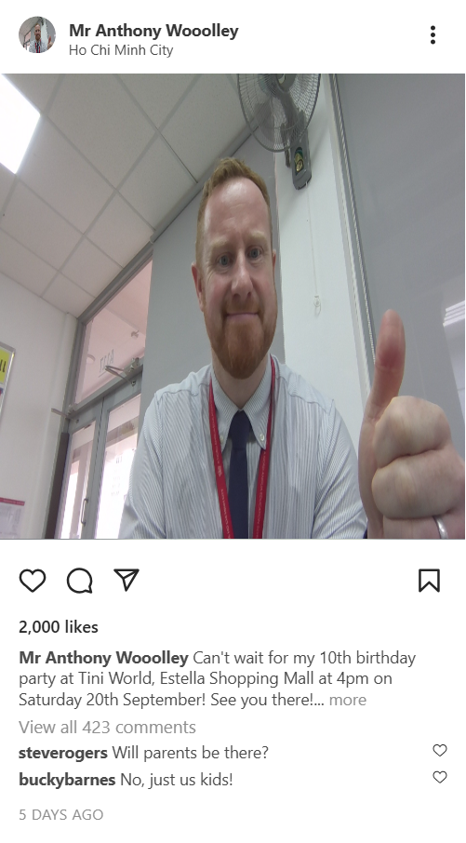
Am I sharing too much information?

Slide 20
Quiz time!
Test you knowledge on Google Slides
Notes:
Need to source appropriate quiz

Slide 21
Shut down your laptop:
After every lesson please shut the laptop down so it is ready for the next person!

Slide 22
